Slide 1


TERROR & TOURISM
Presented by Christopher Jacks
Notes:
Outline :
1. The Problem
2. The Data
3. Model – Evaluation and What I learned
4. Next Steps

Slide 2


THE
PROBLEM
On March 23rd
2016, the 23 room boutique hotel …
The aftermath of terrorism effects many. The tourism industry especially. ‘Boutique’ and ‘niche’ players say they struggle to recover. And are pressed to decide whether lowering prices or offering value added packages would be the solution.
225 Cancelations
Notes:
Notes:
Rooms are a perishable good. Events like these that cause mass cancelations can really hurt a P&L statement
New York alone has 1,887
And 30+ hotels with rooms 500 or more mores
The United States’ share of total international arrivals is 6.1% (down from 7.5% in 2000).
Tourism in the US is a 1.5 trillion dollar industry
Goal:
Finding terrors affect on the travel industry is the first step in building a model that could predict hotel occupancy and suggest an average daily room-rate to achieve revenue targets.
Source:
https://www.hosco.com/en/advice/article/how-hotels-protect-themselves-after-a-terrorism-eventes:

Slide 3
THE
DATA
TERRORISM
Global Terrorism Database 1970 – 2016 source: Kaggle
International Arrivals 1997-2016 source: National Travelers and Tourism Office
Historical Stock Prices 1980 -2017 source: Kaggle source: Yahoo Finance!
INDUSTRY
Performance
ARRIVALS
Notes:
1. Global Terrorism Database
More than 170,000 terrorist attacks worldwide, 1970-2016 (missing 1993)
Variables: >100 variables on location, tactics, perpetrators, targets, and outcomes
The Global Terrorism Database is funded through START, by the US Department of State

Slide 4
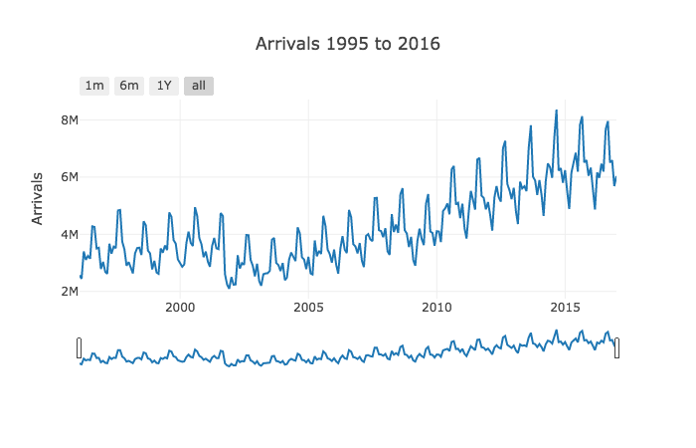
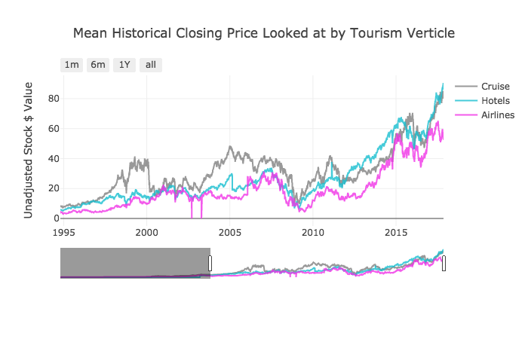
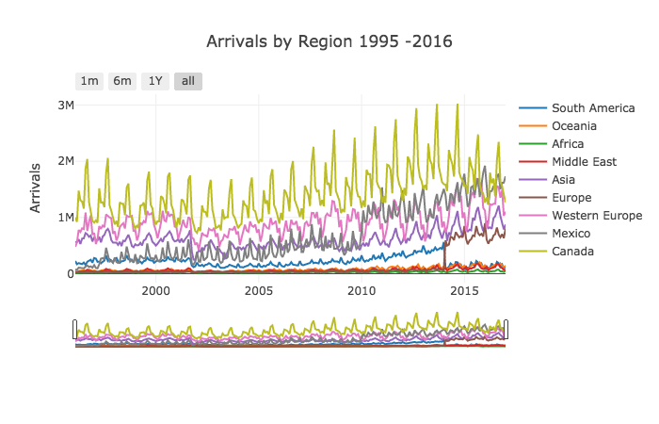
THE
FINDINGS (1994 onwards)
Notes:
Industry Trends along a simmiliar line

Slide 5
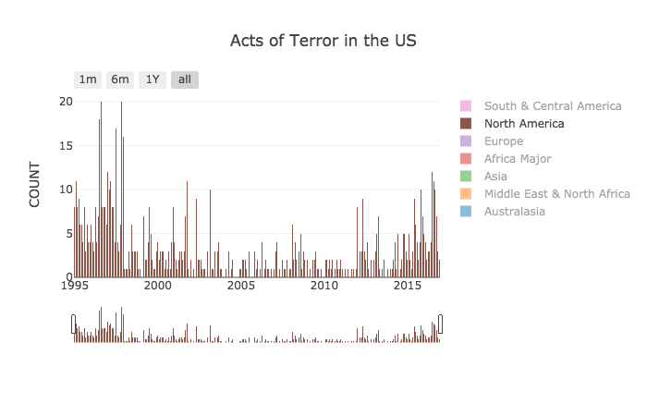

Slide 6
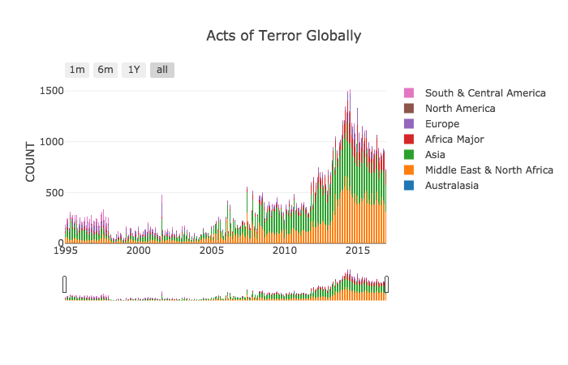

Slide 7
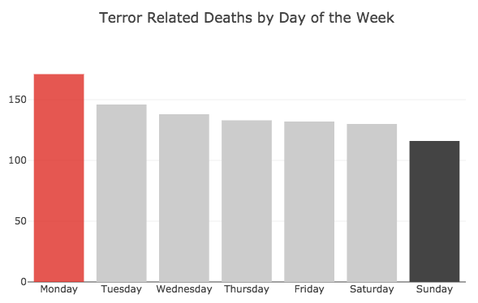

Slide 8
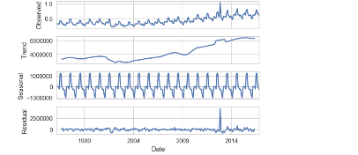
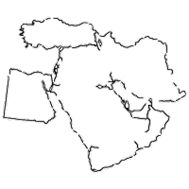

THE
MODEL
Grid Searched Gradient Boost Classifier
TN
FP
39
14.2
Goal: Predict if total international arrivals in to the US will increase or decrease in the next month.
Baseline: 56%
Best Model Score: 76%
9.5
39
FN
TP
TOP FEATURES
Diff
Diff
3mo
3mo
3mo
3mo
BOTTOM FEATURES
Notes:
Why Gradient Boost Classifier?
Parameters:
Max depth 3
Max features log 2
N_estimators: 100
R2 Score
Whats the accuracy?
And other metrics

Slide 9

NEXT
STEPS
Reduce dimensionality of my current features to reduce multicollinearity in the chosen variables.
In Summary,
Add new features, such as ‘Accessibility Score’ based on travel regulation rulings that can then be used in the model.
“All great journeys begin with a single step.”
Begin exploring how I can predict occupancy percentage and average ADR by area and by property.

Slide 10
Thank You and Safe Travels
To learn more, share, or follow my journey visit us at; myrandomsamples.com
Notes:
Outline
1. The Problem
2. The Data
3. Model – Evaluation and What I learned
4. Next Steps

Slide 11
Notes:
Outline
1. The Problem
2. The Data
3. Model – Evaluation and What I learned
4. Next Steps

